Slide 1
Colonisation Of Mars
What challenges do martian colonizers face?

Slide 2
Why Mars?
Mars is one of the closest habitable planets (average distance of 140 million miles away)
Mars is about 1.5 times further from the Sun, than Earth, so has good sunlight (it is a little cold, but we can counteract that)
Mars’ atmosphere is primarily CO₂ (some N₂ and Ar) meaning we can grow planets by compressing the atmosphere
Gravity on Mars is approximately 38% of that on Earth (so we can lift heavy things easily, and bound around)
The martian day is very close to Earth’s day (24hr 37 minutes) so our habits won’t need to be altered
Mars is just over half the size of Earth, so there is plenty of room!
BUT the WiFI is dodgy at best at the moment!

Slide 3
What Challenges Do Martian Colonizers Face?
Getting to Mars
Rules/Government
Lack of Breathable Air
Establishing a Martian Culture
Lack of Drinkable Water
Expanding
Lack of Power
Becoming Self-Sufficient
Lack of Food

Slide 4
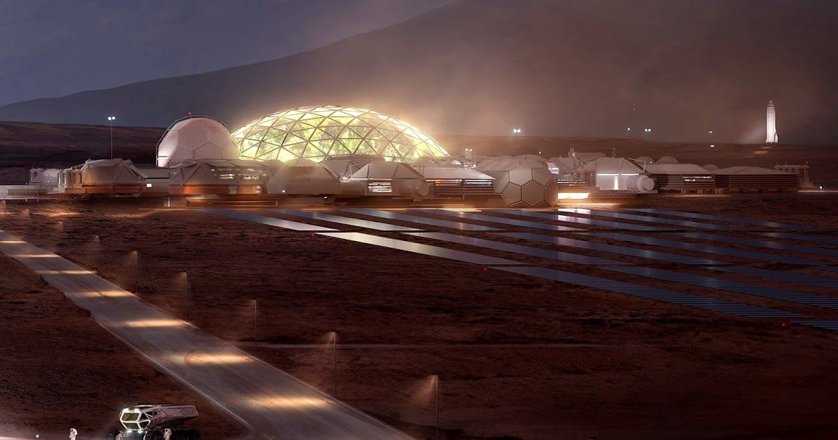
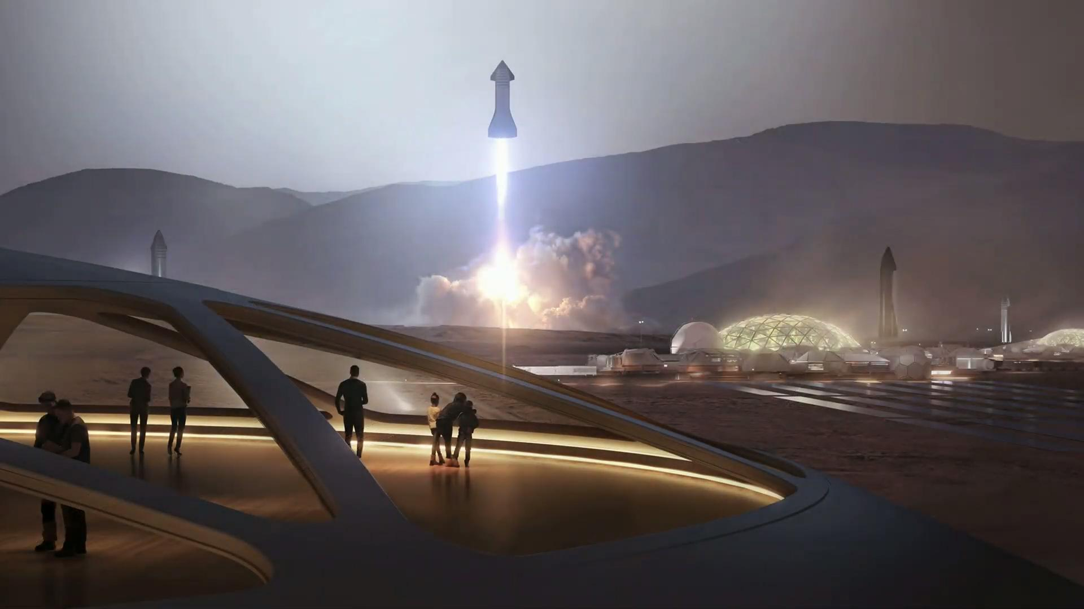
Elon Musk’s SpaceX

Slide 5
Starship
SpaceX’s Starship are the proposed vehicles to enable the colonization of Mars.
Starship Spacecraft
Designed to transport crew and cargo
Super Heavy Rocket
Designed to transport cargo
Starship will be the world’s most powerful launch vehicle ever developed, with the ability to carry in excess of 100 metric tonnes (that’s 15 Male African Elephants) to Earth orbit.
With a height of 120 metres and diameter of 9 m, Starship is an impressive structure powered by Raptor engines which have a thrust of 2,000,000 Newtons! (that’s the weight of around 16 London Double Decker Buses, from one engine!)

Slide 7
Reality
We have talked about some pretty fascinating science, which admittedly seems very far away from now, and some might say impossible.
But remember we only landed on the moon in 1969, and the first airplane was only in 1903. So is it really just fantasy…
In 2023, Japanese entrepreneur Yusaku Maezawa and the crew of dearMoon will become the first civilians passengers on a lunar Starship mission, featuring a fly-by of the Moon during a week-long journey.
That is some holiday! Admittedly Spain is quite good too!

Slide 8
On Wednesday 5th May 2021, Starship 15 successfully completed SpaceX’s first high-altitude flight test of a Starship prototype from Starbase, Texas.

Slide 9
So is Mars, still only a fantasy?
Only time will tell.

